Slide 1

Strategies

Slide 2
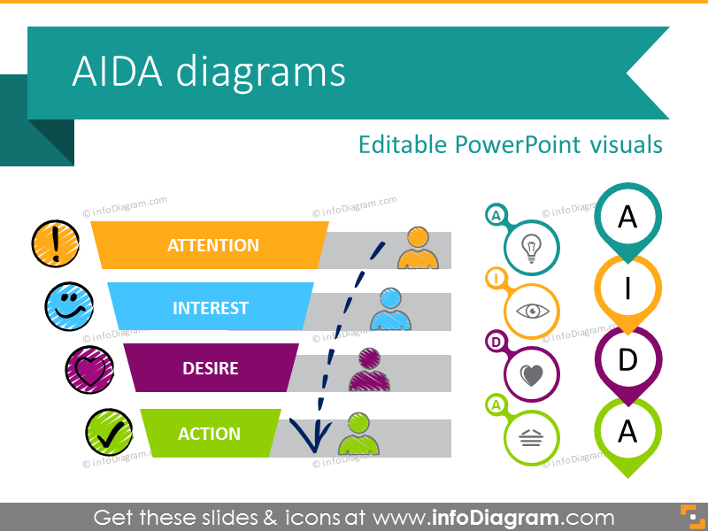
Consumer Oriented Digital Marketing Strategy
The consumer Decision Journey
AIDA-Model (Awareness, Interest, Desire, Action)

Slide 3
Consumer Oriented Digital Marketing Strategy
The P-O-E-M Framework
Paid Media
Owned Media
Earned Media
Segmenting and Customizing Messages
The Digital Landscape

Slide 4
Digital Marketing Plan
Objectives
Buyer Personas
Content
Channel
Timelines
Budget
Measurement

Slide 5
Display Advertising
It is a the act of communicating the advertising message using rich media.
Objective:- Build Brand
Display Ads
a) Native advertisement: The ad content and outlook is native to he environment of the page on which it is being displayed.
b) Non-native: Non-Native ads are easily identifiable and differentiable

Slide 6
Types of Displayl Advertising
Format
Image ads
Rich media ads
Video ads
Display Ad Size
Medium Rectangle
Large Rectangle
Learderboard
Half Page
Large Mobile Banner
Large Format ads

Slide 7
Display Plan
Site
Section
Ad size
Impressions
Rate
Cost

Slide 8
Site | Section | Ad Unit | Impressions | Duration | CPM | Cost
Yahoo | Home Page | LREC Expando | 1750000 | 2 days | 150 | 260000
 | Movies | LREC | 500000 | 6 weeks | 180 | 95000
 | Mail | Super Roll Over | 1500000 | 3 weeks | 75 | 115000
 | Messenger | LREC | 1000000 | 3 weeks | 180 | 175000
Yahoo Total |  |  |  |  |  | 645000
IBN Live | Home Page | Innovation | 1200000 | 2 days |  | 150000

Slide 9
Targeting
Reaching to the right audience
Contextual Targeting
Keywords
Topics
Placement Targeting
Web pages, Videos, RSS feeds
Remarketing
Interest Categories
In-market Audience

Slide 10
What Makes a Good Ad
CTR is higher for highly creative ads
Strong CTA (Call to Action)
Include price
Aesthetics
Unique selling proposition
Show two ads with two offers to the target audience

